Slide 1

MEDIWISE - A Healthcare Chatbot using NLP
SRM INSTITUTE OF SCIENCE AND TECHNOLOGY
SCHOOL OF COMPUTING
DEPARTMENT OF COMPUTING TECHNOLOGIES
18CSP107L - MINOR PROJECT
Batch ID: B028
Student 1 Reg. No: RA2011003010098
Student 1 Name:Aniket Mishra
Student 2 Reg. No: RA2011003010124
Student 2 Name: Nandini Nigam
Guide name: Dr. T.K Sivakumar
Designation: Assistant Professor (Senior Grade) Department: CTECH

Slide 2
MEDIWISE
Abstract
This project aims to develop an innovative and intelligent conversational agent to enhance healthcare services and improve patient experiences.
It is designed to provide a wide range of healthcare-related
services like symptom assessment, health education, and general medical inquiries.
Through its intuitive interface and empathetic conversational style, the chatbot aims to bridge the gap between patients and healthcare providers, promoting efficient communication and reducing the burden on medical staff.
This project aims to provide a scalable, accessible, and user-friendly solution
that can be integrated into existing healthcare platforms contributing to the overall improvement of healthcare delivery and patient outcomes.

Slide 3
MEDIWISE
Introduction
In the rapidly evolving landscape of healthcare, technology has emerged as a transformative force, reshaping how medical services are delivered and experienced.
Mediwise aims to harness the power of cutting-edge artificial intelligence and natural language processing to revolutionize patient interactions
The development of an intelligent conversational agent holds immense potential
to bridge gaps, enhance patient engagement, and streamline medical processes.
By leveraging technology’s effectiveness, this endeavor aspires to cultivate a more patient- centric, efficient, and responsive healthcare ecosystem.

Slide 4
MEDIWISE
Existing System
Conversational Empathy
Comprehensive Healthcare Services
Diverse Data Integration
Use of efficient technology along with enhancements
User Centric Designs
Scalability
Flexible Design

Slide 5
MEDIWISE
Problem statement and Objectives
"Mediwise," connects patients and healthcare providers, aiding tasks like symptom assessment and medical queries.
The chatbot aims to empower patients, improve communication, and advance healthcare technology with NLP algorithms and data insights.
The goal is efficient, patient-centric care, revolutionizing healthcare delivery for improved outcomes and seamless tech integration.
This project aims to use AI and natural language processing to create a smart conversational agent that overcomes limitations in traditional patient-provider communication.
By offering personalized and immediate assistance, individuals can access medical information and understand health conditions.
Additionally, it lightens the load on medical staff, allowing for improved resource allocation and focused patient care.

Slide 6
MEDIWISE
Proposed System
This Project introduces a revolutionary conversational agent with innovations including:
1. Advanced NLU: Understands context for precise responses.
2. Emotionally Aware: Responds empathetically, adapting to users' emotions.
3. Dynamic Learning: Improves over time with continuous learning.
4. Comprehensive Services: Offers various healthcare services.
5. Integration: Seamlessly fits into existing healthcare platforms.
6. Real-time Analytics: Provides insights into patient needs and trends.

Slide 7
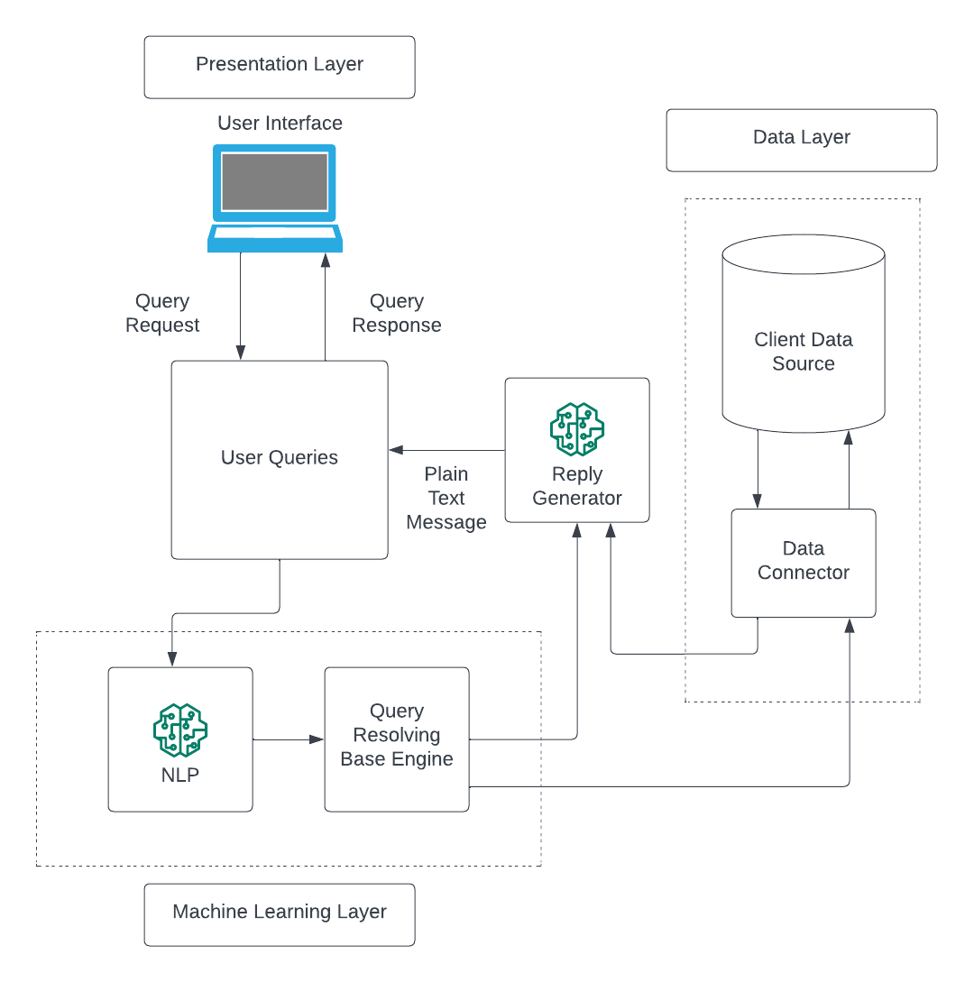
MEDIWISE
Architecture/Block Diagram of the proposed model

Slide 8
MEDIWISE
Modules Description
The Healthcare Chatbot project utilizes a combination of programming languages and libraries to achieve its goals:
Python is used as its primary language
Natural Language Processing (NLP) Libraries:
NLTK (Natural Language Toolkit): Used for various NLP tasks like tokenization, stemming, and sentiment analysis.
spaCy- Offers advanced NLP capabilities
Machine Learning and AI Libraries:
For data preprocessing.
For developing and training

Slide 9
MEDIWISE
Modules Description
4. User Interface Libraries:
HTML, CSS, JavaScript: For building the user interface of the web application.
5. Data Analytics Libraries:
Pandas: For data manipulation and analysis.
NumPy: For numerical computations.
6. Web Frameworks:
Flask: For creating the web application interface and managing user interactions.
7. Cloud Services:
Amazon Web Services (AWS) or Microsoft Azure: For hosting and deploying the chatbot application.

Slide 10
MEDIWISE
Algorithms
The project utilizes the following algorithms:
Vectorization
Vectorization is jargon for a classic approach of converting input data from its raw format (i.e. text ) into vectors of real numbers which is the format that ML models support. This approach has been there ever since computers were first built, it has worked wonderfully across various domains, and it’s now used in NLP. In Machine Learning, vectorization is a step in feature extraction. The idea is to get some distinct features out of the text for the model to train on, by converting text to numerical vectors.
https://neptune.ai/blog/vectorization-techniques-in-nlp-guide

Slide 11
MEDIWISE
Algorithms
The project utilizes the following algorithms:
2. Cosine Similarity
After vectorizing the user's symptoms and a dataset of known symptoms (presumably from a medical database), the code calculates the cosine similarity between these vectors. Cosine similarity is often used to measure the similarity between two vectors in a high-dimensional space, such as text documents.
https://www.sciencedirect.com/topics/computer-science/cosine-similarity

Slide 12
MEDIWISE
Algorithms
The project utilizes the following algorithms:
3. Jump Search
Like Binary Search, Jump Search is a searching algorithm for sorted arrays. The basic idea is to check fewer elements (than linear search) by jumping ahead by fixed steps or skipping some elements in place of searching all elements. It identifies diseases that are most similar to the user's symptoms based on the cosine similarity scores. It finds the disease(s) with the highest similarity score(s) and returns them as predictions. Time Complexity : O(√n), the time complexity of Jump Search is between Linear Search ((O(n)) and Binary Search (O(Log n)).
https://www.geeksforgeeks.org/jump-search/

Slide 13
MEDIWISE
Algorithms
The project utilizes the following algorithms:
4. Merge Sort
Merge sort is a highly efficient sorting algorithm, ideal for handling larger datasets. Its divide-and-conquer approach breaks the input into smaller, sorted segments before merging them, guaranteeing a consistent O(n log n) time complexity. This stability and predictable performance make merge sort a popular choice in scenarios where sorting large volumes of data quickly and reliably is essential, such as database management and external sorting tasks.
https://www.geeksforgeeks.org/merge-sort/

Slide 14
MEDIWISE
Algorithms
The project utilizes the following algorithms:
5. Data Cleaning
Data cleaning is a crucial step in the machine learning (ML) pipeline, as it involves identifying and removing any missing, duplicate, or irrelevant data. The goal of data cleaning is to ensure that the data is accurate, consistent, and free of errors, as incorrect or inconsistent data can negatively impact the performance of the ML model.
https://www.tableau.com/learn/articles/what-is-data-cleaning

Slide 15
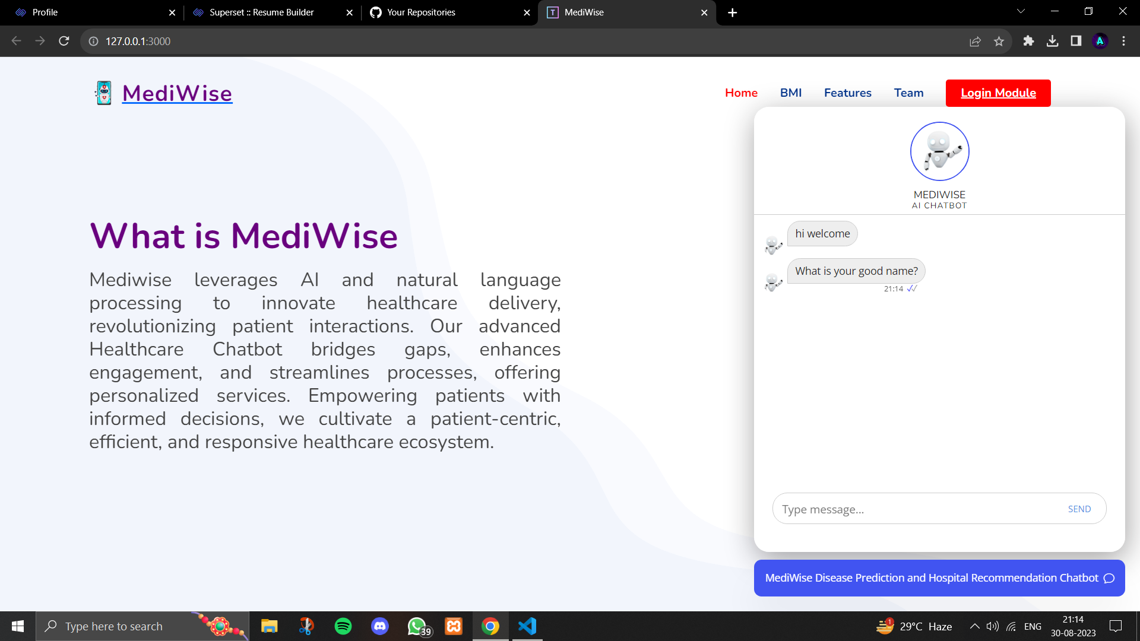
MEDIWISE
Intermediate Results and Discussion

Slide 16
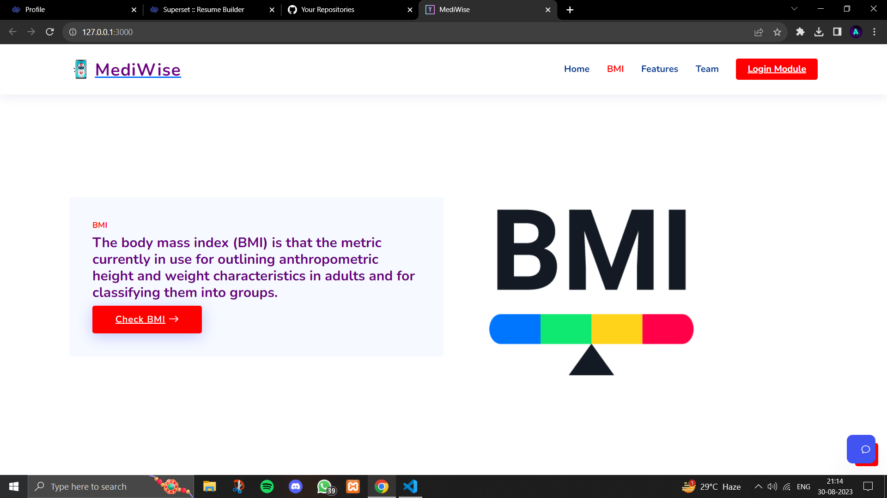
MEDIWISE
Intermediate Results and Discussion

Slide 17
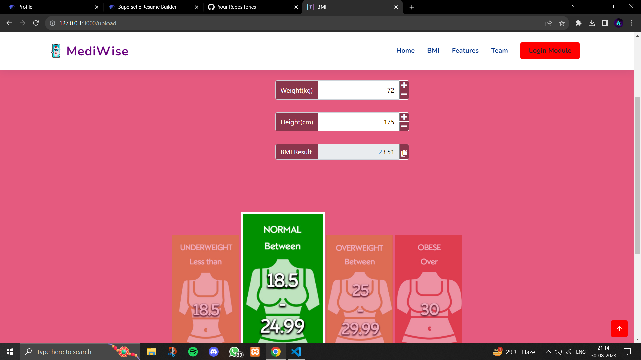
MEDIWISE
Intermediate Results and Discussion

Slide 18
MEDIWISE
References
Paper 1: Chatbot for Healthcare System Using Artificial Intelligence
Author: Lekha Athota - Amity University, Dubai, UAE, Vinod Kumar Shukla - Amity University, Dubai, UAE, Nitin Pandey - Amity University, Noida, UP, India, Ajay Rana- Amity University Uttar Pradesh, Noida, India
Publisher: IEEE
Published Date: Tuesday, September 15, 2020
Link: https://ieeexplore.ieee.org/document/9197833

Slide 19
MEDIWISE
Paper 1: Chatbot for Healthcare System Using Artificial Intelligence
Pros | Cons
24/7 Accessibility to Healthcare Information Cost-Efficiency through Cost Savings Time-Saving by Eliminating Appointment Scheduling Scalability for Handling Numerous Queries Efficient Data Storage and Retrieval Improved Response Relevancy through Keyword Matching Expert Program Integration Privacy Considerations Educational Potential Enhanced User Engagement | Limited Accuracy in Diagnosing Complex Conditions Incapability to Handle Emergencies Risk of Over-Reliance on Chatbots for Serious Health Issues Language Limitations Need for Ongoing Maintenance and Updates Potential Misinterpretation of User Queries Dependency on Internet Access

Slide 20
MEDIWISE
References
Paper 2: Mega Bot – The Healthcare Chatbot
Author: Megarajan G
Publisher: IEEE
Published Date: Thursday, 23 September 2021
Link: https://ieeexplore.ieee.org/document/9533025

Slide 21
MEDIWISE
Paper 2: Mega Bot – The Healthcare Chatbot
Pros | Cons
Utilizes Cutting-Edge Technologies: ML, AI , IOT and Deep Learning Symptom and Temperature Monitoring: Features Offered: Face Checkup: Assesses emotions. Fever Checkup: Detects body temperature. Integrates Infermedica API: Handles symptom analysis using third-party data. Emphasizes the Need for Automated Diagnostic Tools: | More Detailed Explanation Needed for Decision Tree Classification More Detailed Explanation Needed for Artificial Neural Networks in Face Checkup Better Connection Needed Between the Discussion on Automated Diagnostic Tools and Project Objectives

Slide 22
MEDIWISE
References
Paper 3: Natural Language Processing and Its Applications in Machine Translation: A Diachronic Review
Author: Kai Jiang - College of Foreign Languages, Huazhong Agricultural University, Wuhan, China, Xi Lu - Department of Common Required Courses, Hubei Institute of Fine Arts, Wuhan, China
Publisher: IEEE
Published Date: Monday, February 01, 2021
Link: https://ieeexplore.ieee.org/document/9332458

Slide 23
MEDIWISE
Paper 3: Natural Language Processing and Its Applications in Machine Translation: A Diachronic Review
Pros | Cons
Comprehensive Overview of NLP and MT Relationship Recognition of Interdisciplinary Nature in Linguistics, Computer Science, and Mathematics Analysis of Progress Curve Practical Applications of NLP in MT Addressing Ethical Concerns Regarding Automation Forward-Looking Perspective on the Future of MT in AI | Lack of Specific Technical Details Potential Outdated Information (2020 Publication Date) Need for a Deeper Examination of Ethical and Societal Implications Clarity Required Regarding Mentioned Regions or Countries Limitations Due to the Conference Paper Format

Slide 24
MEDIWISE
References
Paper 4: An AI-Based Medical Chatbot Model for Infectious Disease Prediction
Author: Sanjay Chakraborty, Hrithik Paul, Sayani Ghatak, Saroj Kumar Pandey,
Ankit Kumar, Kamred Udham Singh, Mohd Asif Shah
Publisher: IEEE
Published Date: Tuesday, December 06, 2022
Link: https://ieeexplore.ieee.org/document/9970731

Slide 25
MEDIWISE
Paper 4: An AI-Based Medical Chatbot Model for Infectious Disease Prediction
Pros | Cons
Improved Accessibility: Particularly beneficial in emergencies or remote areas. 24/7 Support: Cost-Efficient:Especially beneficial for handling a large volume of user inquiries. Quick Response Time: Can efficiently handle large volumes of medical information. Training Model: Outlines the process of building a training model using TensorFlow and NLP. | Accuracy: Chatbot responses depend on data quality, risking misinformation. Limited Scope Loss of Human Touch Developing and maintaining medical chatbots is complex and requires continuous updates. Ethical and Privacy Concerns Language Limitations Dependency on Technology: Can Lead to over-dependence.

Slide 26
MEDIWISE
References
Paper 5: A Survey on Chatbot Implementation in Health Care using NLTK
Author: J. Jinu Sophia, Assistant Professor, Rajalakshmi Engineering College
D. Arun Kumar, Student, Rajalakshmi Engineering College
M. Arutselvan, Student, Rajalakshmi Engineering College
S. Barath Ram, Student, Rajalakshmi Engineering College
Publisher: International Journal of Computer Science and Mobile Computing
Published Date: Tuesday, March 03, 2020
Link: https://ijcsmc.com/docs/papers/March2020/V9I3202029.pdf

Slide 27
MEDIWISE
Paper 5: A Survey on Chatbot Implementation in Health Care using NLTK
Pros | Cons
Cost-effective & Accessible: Efficient Interaction: Raises health awareness. Tailored diagnoses based on symptoms. User-friendly Interface: AI Integration: Enhanced comprehension with NLP and ML integration. | Limited understanding in complex cases. Scope Limitations Challenges in protecting sensitive healthcare data. Struggles with complex or ambiguous inputs. Data Quality Dependency Lack of Empathy: Inadequate in emotionally sensitive situations. Over-Reliance Risk: Potential neglect of proper medical attention. Maintenance Complexity

Slide 28
MEDIWISE
References
Paper 6: The evaluation of chatbot as a tool for health literacy education among undergraduate students
Author: Nur Azlina Mohamed Mokmin, Nurul Anwar Ibrahim
Publisher: National Library of Medicine - National Center for Biotechnology Information
Published Date: Tuesday, May 25, 2021
Link: https://www.ncbi.nlm.nih.gov/pmc/articles/PMC8144870/

Slide 29
MEDIWISE
Paper 6: The evaluation of chatbot as a tool for health literacy education among undergraduate students
Pros | Cons
Useful Health Advice User Engagement Positive Attitudes Intent Diversity Behavioral Intention Convenient Access | Limited Answers Anxiety: Some users felt anxious using the chatbot for health information. Exit Rate: Many users left sessions prematurely due to unresolved queries. User Assistance: Users wanted more guidance on using the chatbot effectively. Language Understanding: Session Length: Some sessions were brief due to doubts about the chatbot's accuracy.

Slide 30
MEDIWISE
References
Paper 7: The Development and Use of Chatbots in Public Health - Scoping Review
Author: Lee Wilson PhD, Mariana Marasoiu Mphil
Publisher: National Library of Medicine - National Center for Biotechnology Information
Published Date: Wednesday, October 05, 2022
Link: https://www.ncbi.nlm.nih.gov/pmc/articles/PMC9536768/

Slide 31
MEDIWISE
Paper 7: The Development and Use of Chatbots in Public Health - Scoping Review
Pros | Cons
Accessibility: Crucial for urgent health concerns. Scalability Consistency Cost Reduction: They assist in symptom assessment, potentially lowering healthcare costs. Anonymity Offer health information, encourage healthy behaviors, and provide emotional support. | Limited Diagnostic Accuracy: Lack of Empathy Privacy Concerns Overreliance: Overreliance on chatbots may delay seeking professional help. Proficiency and disabilities can hinder effective communication. Ethical Concerns: Using chatbots for mental health raises ethical questions. User Experience Variability: Satisfaction varies based on design and responsiveness.

Slide 32
MEDIWISE
References
Paper 8: News entity classification using NLP
Author: Yaswanth Reddy, Sri Charan, Paul Aditya, Ryan, T. Mathu
Publisher: Institute of Research and Journals
Published Date: Tuesday, August 02, 2022
Link: https://ijacen.iraj.in/paper_detail.php?paper_id=18651

Slide 33
MEDIWISE
Paper 8: News entity classification using NLP
Pros | Cons
Relevance: Addresses the significance of fake news detection in the digital age. Comprehensive Research Clearly outlines preprocessing steps and machine learning techniques. Comparative Analysis: Evaluates the performance of different algorithms. Results: Demonstrates the effectiveness with accuracy results. References: Cites relevant prior research, enhancing credibility. | Data Sources: The paper mentions data collection but does not provide information on the sources of the dataset used Limited Context

Slide 34
MEDIWISE
References
Paper 9: Intelligent AI-based dialogue agent to enhance communication in organ transplant networks
Author: Sumalatha M.R, Aravind Rajagopalan, Kaaviya Peranandam, Vishwa S.S.K.M
Publisher: Institute of Research and Journals
Published Date: Monday, September 09, 2019
Link: http://www.iraj.in/journal/journal_file/journal_pdf/3-596-15734507561-6.pdf

Slide 35
MEDIWISE
Paper 9: Intelligent AI-based dialogue agent to enhance communication in organ transplant networks
Pros | Cons
Efficient Communication: Improves communication in organ transplant networks to save lives. Reduces delays by automating query responses. Utilizes NLP, NLU, NLG, LSTM neural networks Web Scraping for Information Retrieval Multidomain Knowledge: Integrates knowledge from multiple domains, including transplant centers, legal matters, general info, and NGO contacts. | Accuracy depends on data quality and quantity. Training Complexity Requires continuous monitoring and web scraping. Struggles with nuanced queries. Legal and Ethical Concerns: Adherence to ethical and legal standards is vital. Dependency on Web Search: Quality of answers varies based on web sources.

Slide 36
MEDIWISE
References
Paper 10: Healthcare Chatbot using Artificial Intelligence
Author: Anuj Patil
Publisher: International Journal for Research in Applied Science and Engineering Technology
Published Date: Saturday, August 13, 2022
Link:https://www.ijraset.com/best-journal/healthcare-chatbot-using-artificial-intelligence

Slide 37
MEDIWISE
Paper 10: Healthcare Chatbot using Artificial Intelligence
Pros | Cons
Improved Accessibility Faster Responses Efficient Handling of routine tasks reduces operational costs. Promotes health literacy, aiding informed decisions. Remote Monitoring Privacy: Users feel comfortable discussing sensitive issues. Scalability: Chatbots handle high volumes of inquiries. | Lack of Personalization Limited Medical Knowledge Misdiagnosis Risk Ethical Concerns Technical Issues: Glitches and errors can frustrate users. Resistance to Adoption: Concerns about job displacement and AI mistrust. Data Privacy: Robust security measures are needed for handling sensitive health data.

Slide 38
MEDIWISE
Conclusion:
In this phase of the project, significant milestones have been achieved. We have successfully defined our project objectives, providing a clear roadmap for development. Comprehensive research into relevant papers has deepened our understanding of the healthcare chatbot landscape.
Drawing insights from existing systems, we've undertaken a comprehensive comparison and learning process, identifying areas for improvement and innovation. The project's architectural framework has been established, detailing the integration of modules.
Moreover, our modules have been finalized, setting the foundation for advanced functionalities. The initial stages of UI development have commenced, ensuring a user-friendly interface.
With these accomplishments in place, we are poised to move into the next phase, commencing the integration of machine learning models to enhance the chatbot's capabilities.

Slide 39
Thank You

